Slide 1



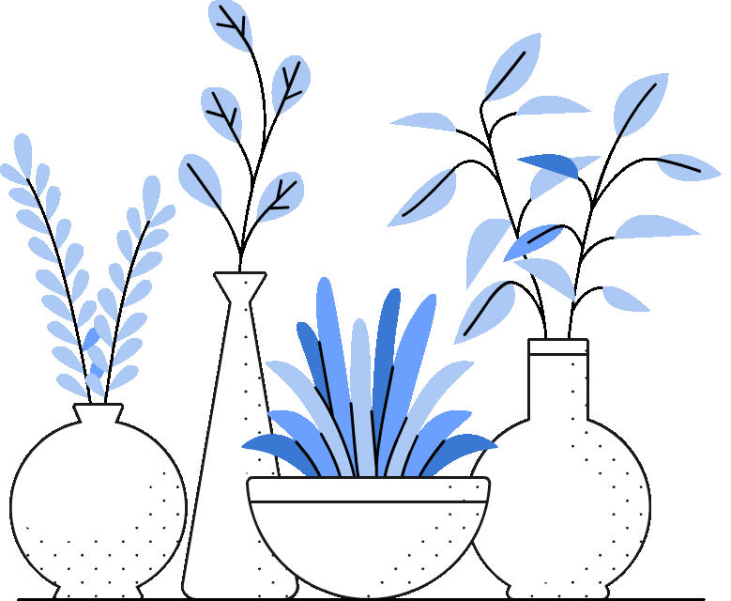
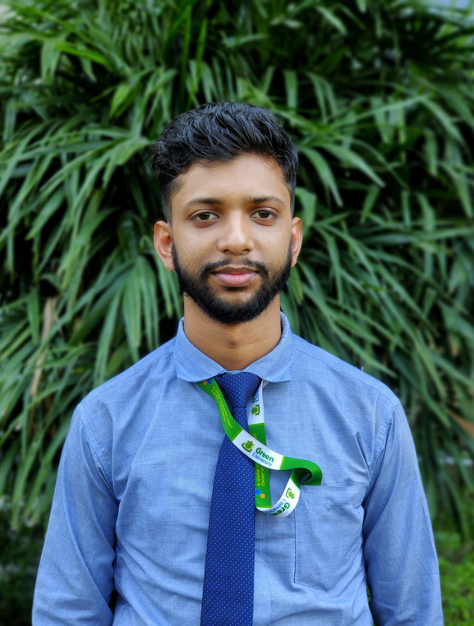
Green University Of Bangladesh
DEPARTMENT OF COMPUTER SCIENCE AND ENGINEERING(CSE)
FACULTY OF SCIENCE AND ENGINEERING
Course Title: English For Academic Purposes Course Code: EAP-103 Section: PC-221DG
Course Instructor
Presented to Arif Jawad Fahim Lecturer, Dept. of CSE Green University Of Bangladesh
Presented By
Md. Mahim Hossain
ID : 221902082

Slide 2
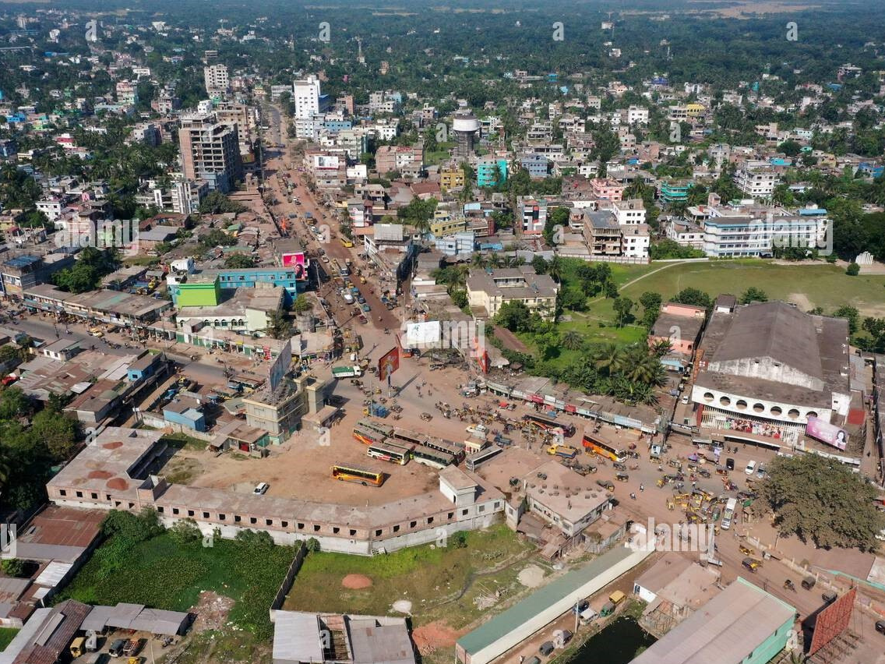
BEAUTY OF JESSORE

Slide 3
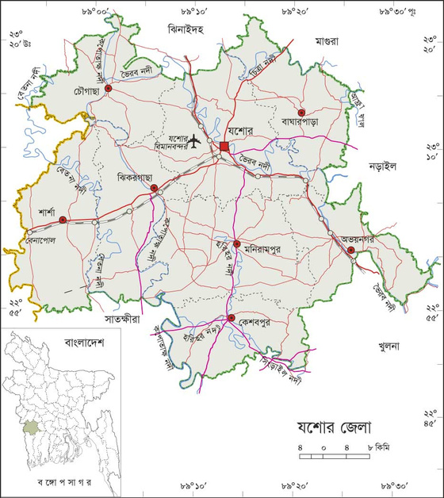
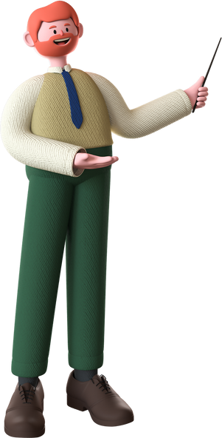

INTRODUCTION

Slide 4

TABLE OF CONTENTS :
TOURIST ATTRACTIONS IN JESSORE

Slide 5
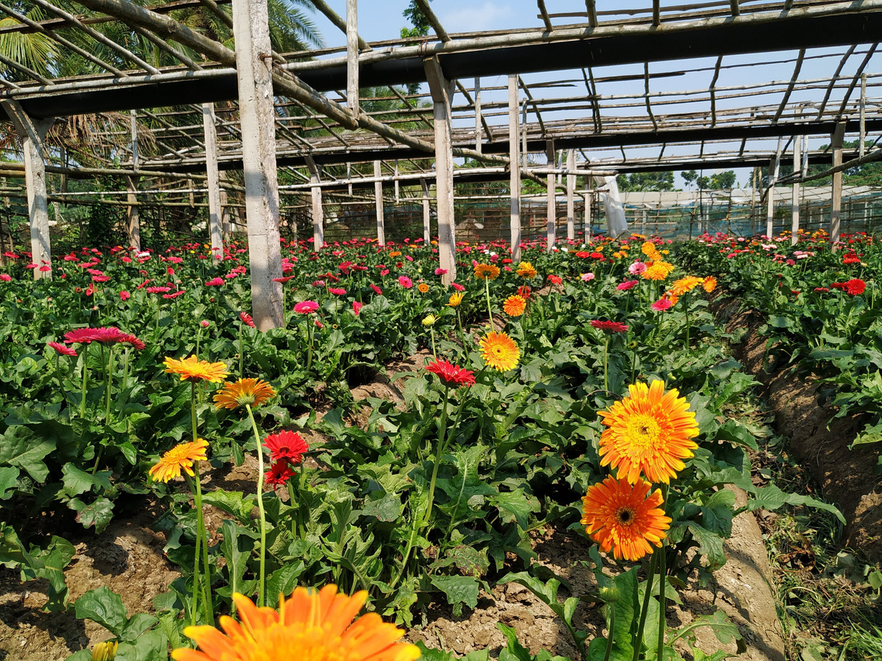
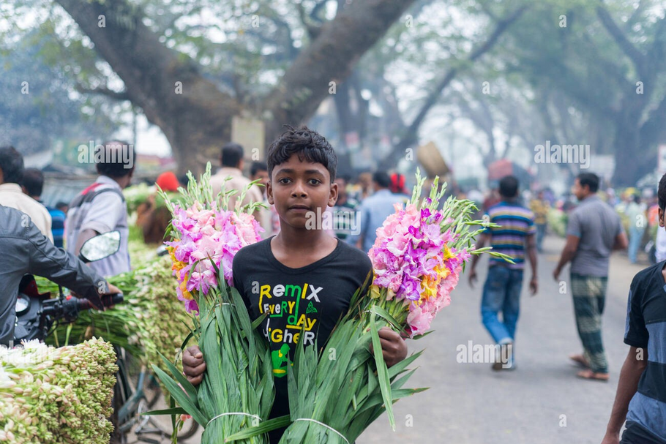
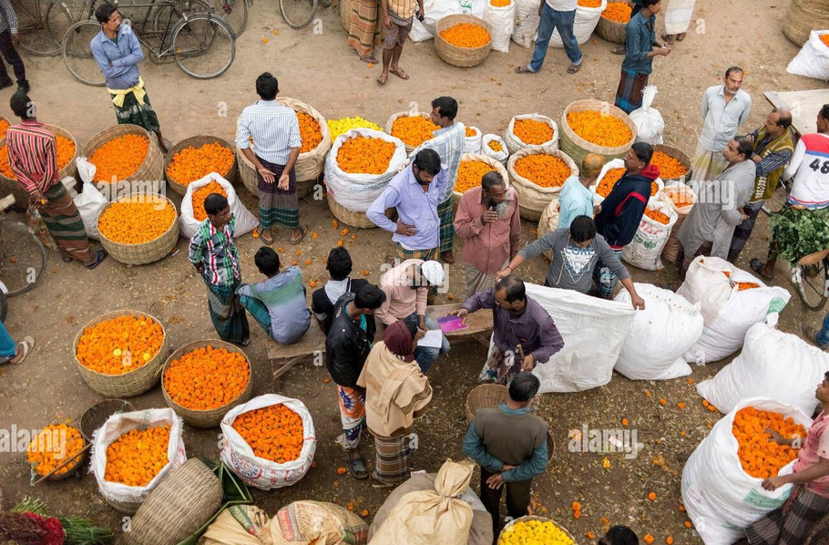
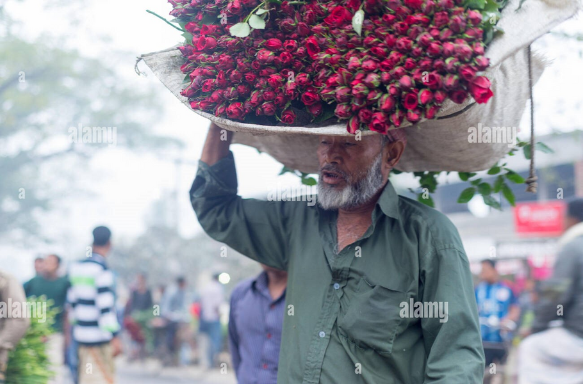
FLOWER CAPITAL OF BANGLADESH :
Godkhali
GODKHALI FLOWER GARDEN IN JESSORE DISTRICT IN KHULNA DIVISION . 12 KM FAR FROM BENAPOL BORDER.

Slide 6
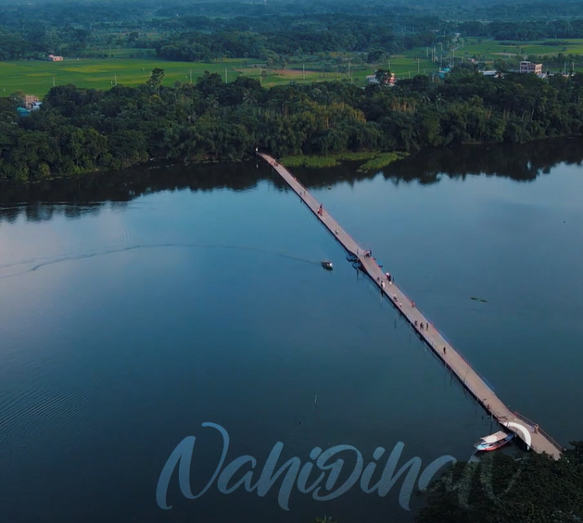
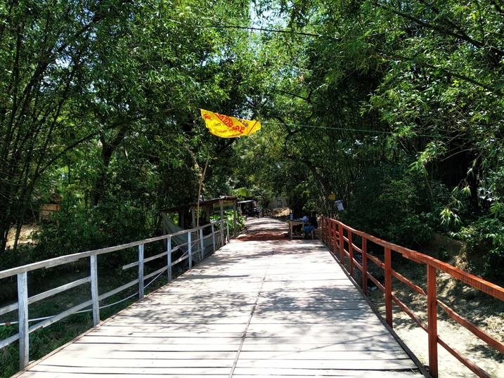
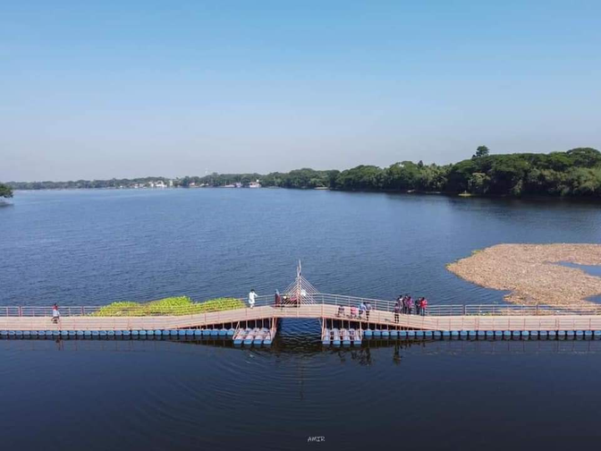
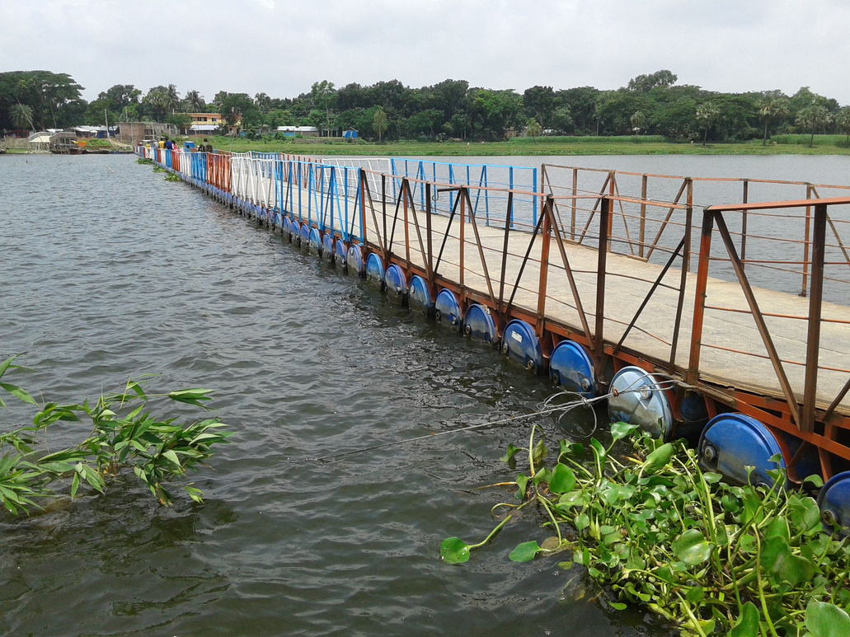
1st ever floating Bridge in Bangladesh : Jhapa Baor
THE PLACE IS SITUATED NEAR THE OLD CITY JESSORE, NAME OF THE PLACE IS RAJGONJ.

Slide 7
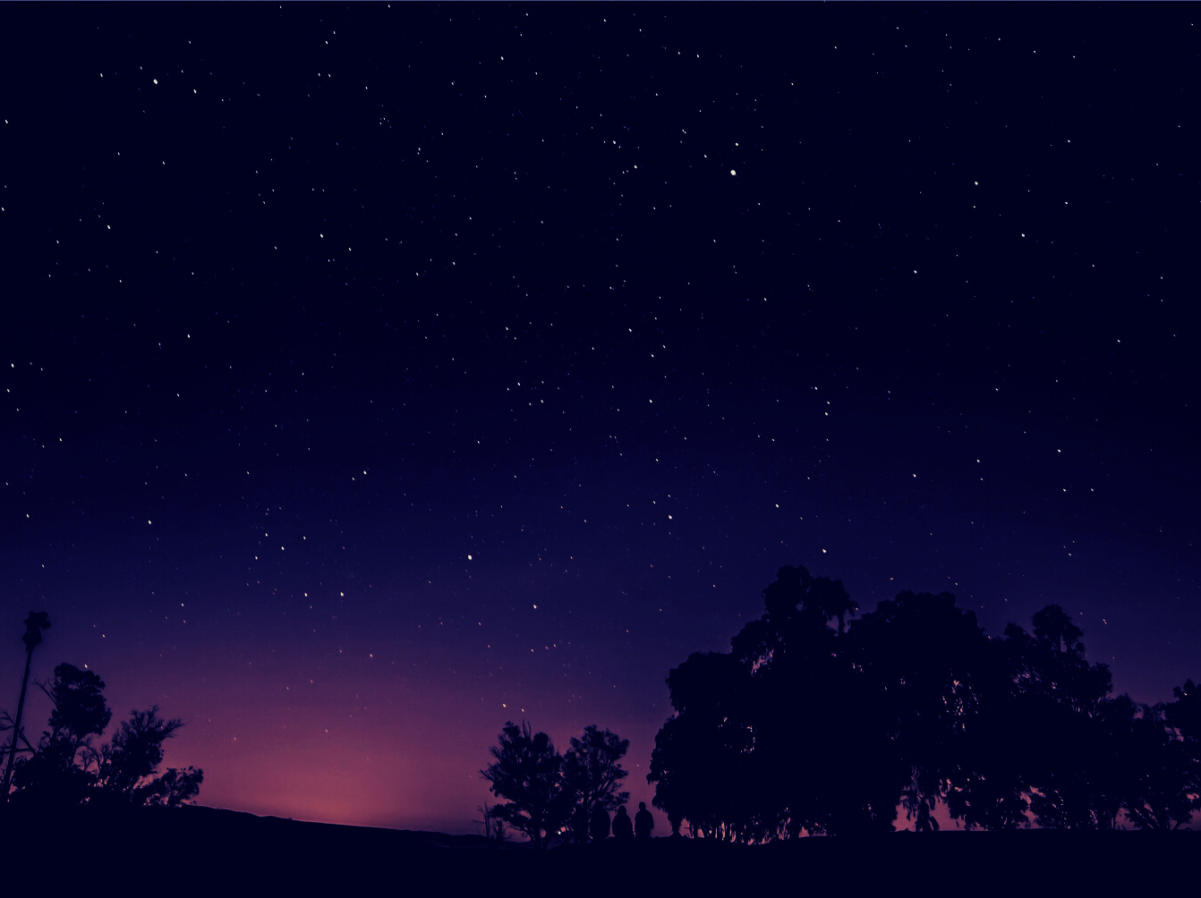


ANY QUESTION ?

Slide 8



